Slide 1
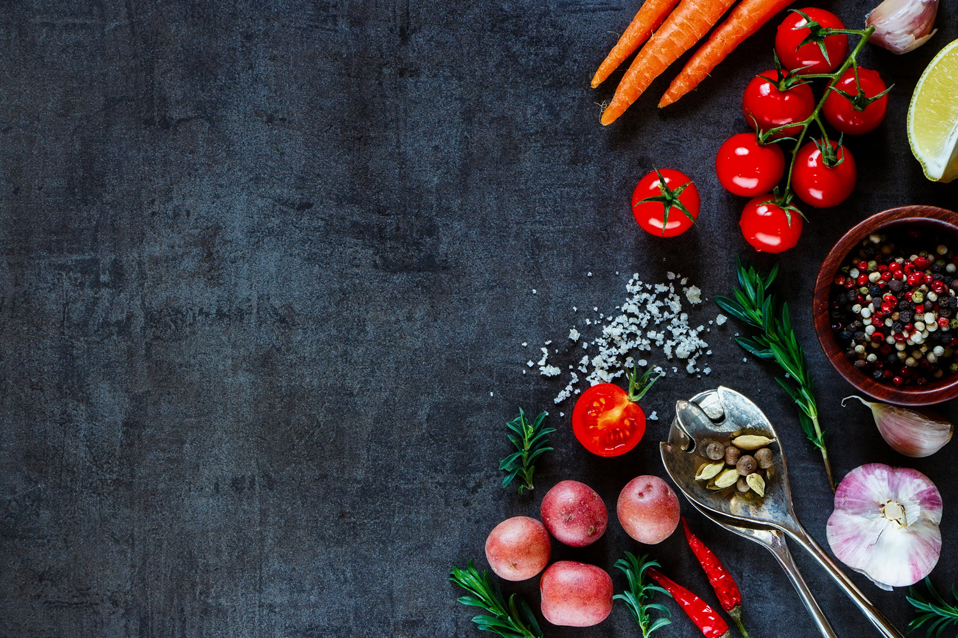
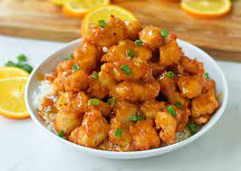
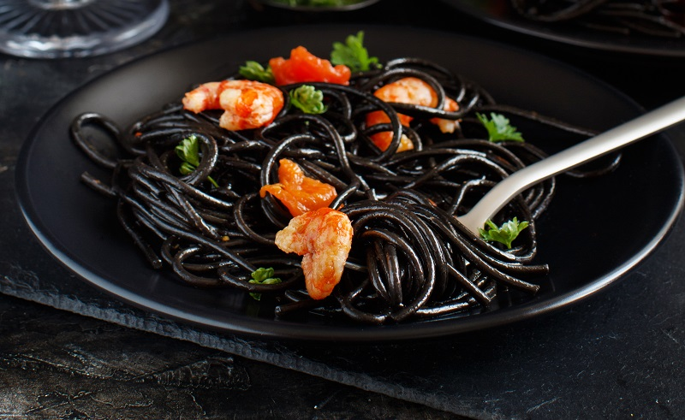
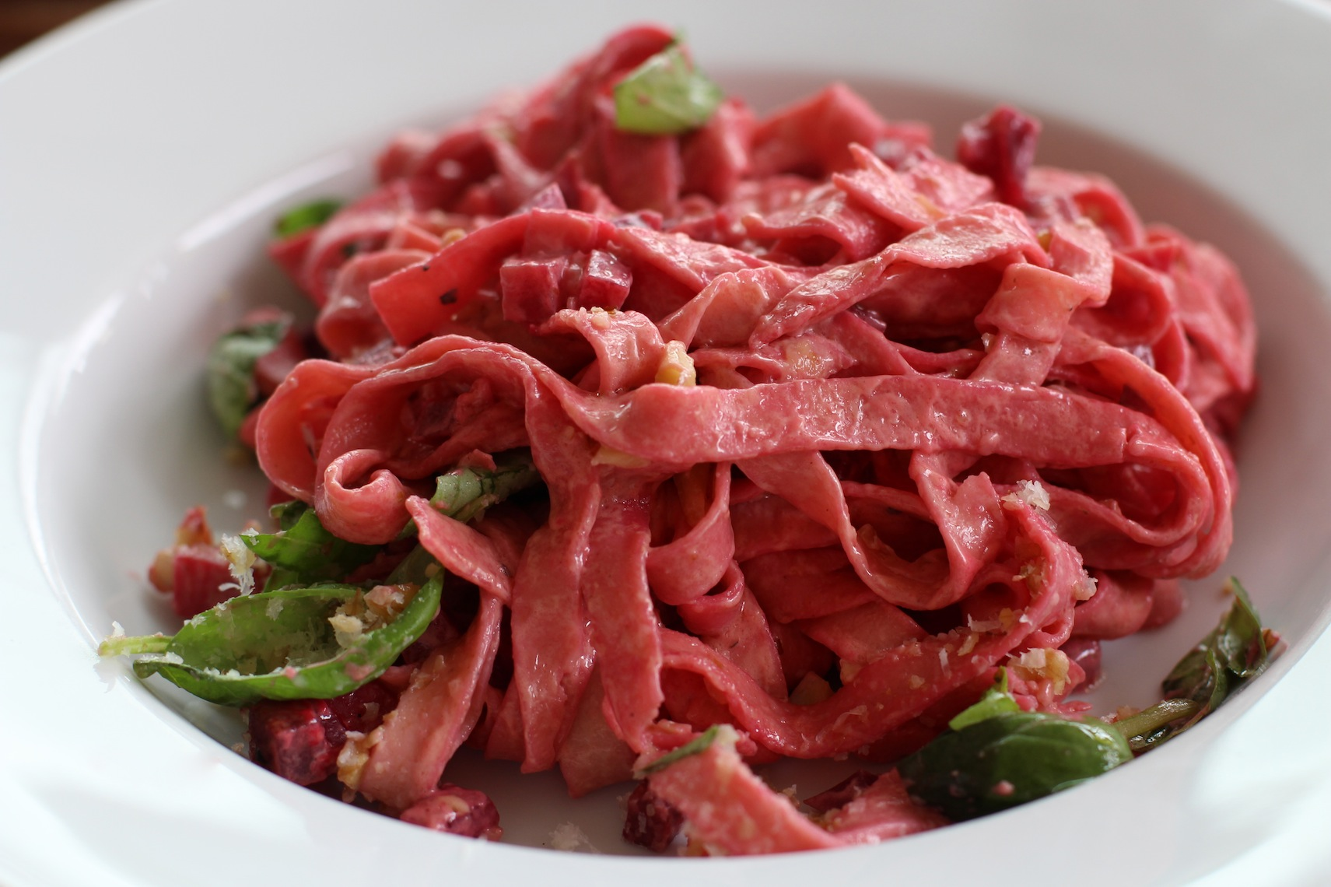
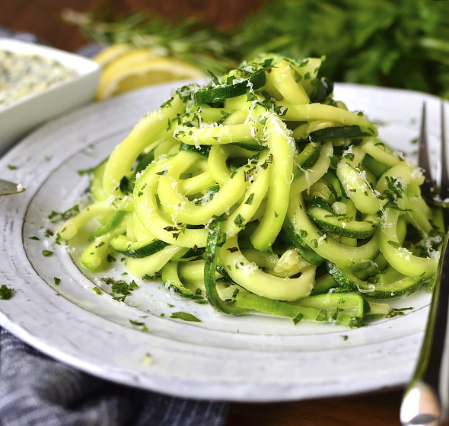
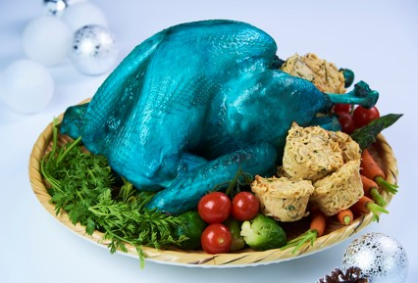
A/B Testing
Which color do you prefer to eat?

Slide 2
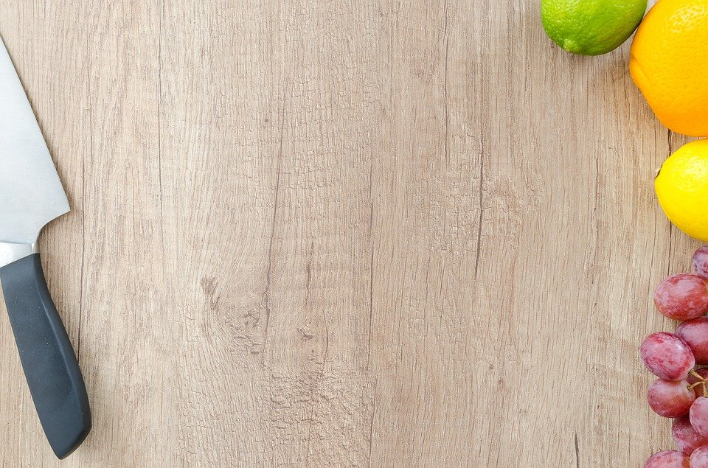
The colors in the test
Red
Orange
Green
Black
Blue

Slide 3
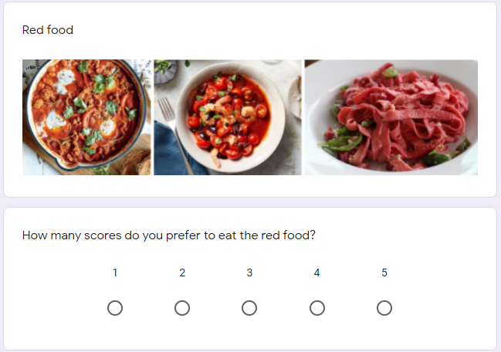
Sample the scoring questionnaire
Link to the full questionnaire : Click
Participants are student in the class and outsider.

Slide 4
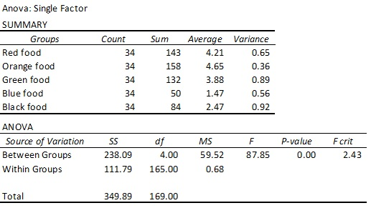
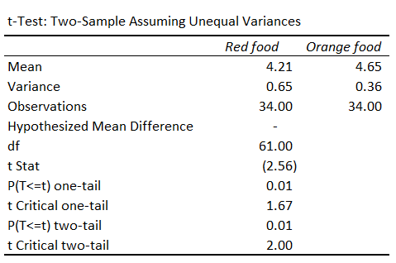
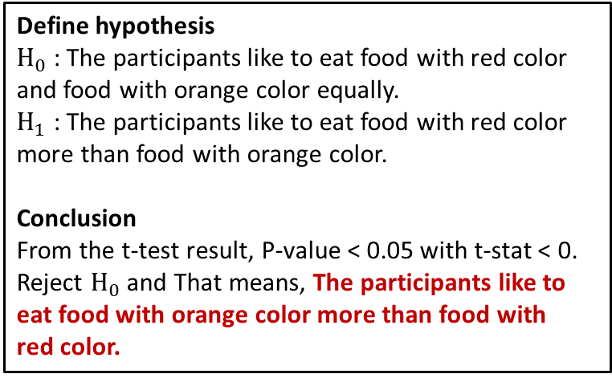
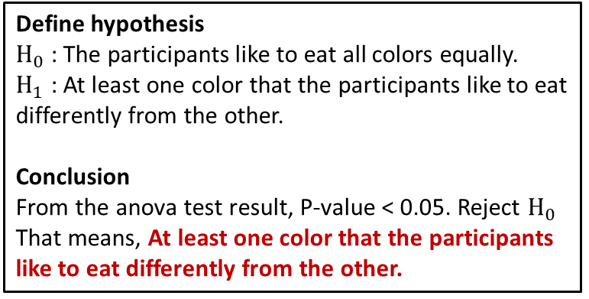
The result
Define hypothesis
$H_{0}$ : The participants like to eat all colors equally.
$H_{1}$ : At least one color that the participants like to eat differently from the other.
Conclusion
From the anova test result, P-value < 0.05. Reject $H_{0}$
That means, At least one color that the participants like to eat differently from the other.
Define hypothesis
$H_{0}$ : The participants like to eat food with red color and food with orange color equally.
$H_{1}$ : The participants like to eat food with red color more than food with orange color.
Conclusion
From the t-test result, P-value < 0.05 with t-stat < 0. Reject $H_{0}$ and That means, The participants like to eat food with orange color more than food with
red color.

Slide 5
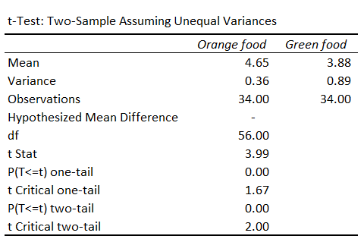
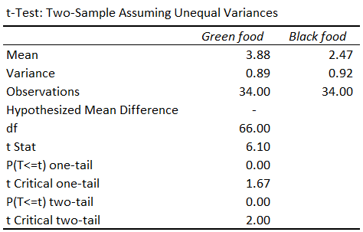
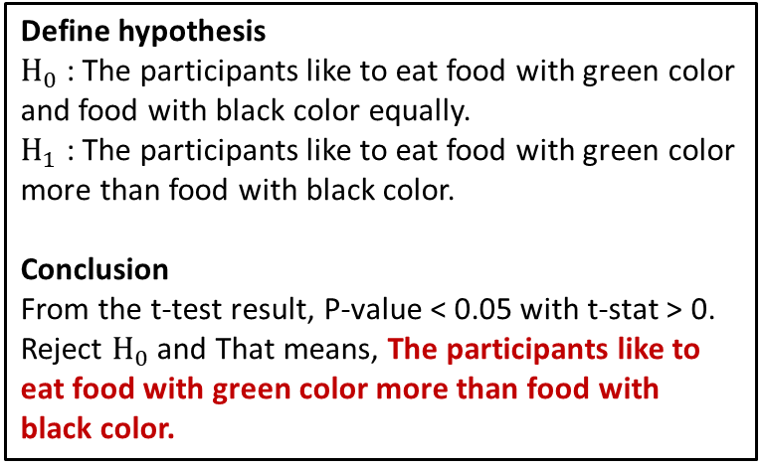
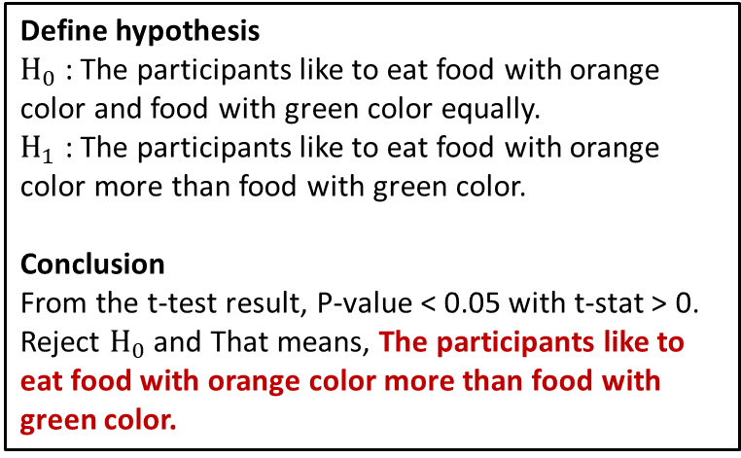
The result
Define hypothesis
$H_{0}$ : The participants like to eat food with orange color and food with green color equally.
$H_{1}$ : The participants like to eat food with orange color more than food with green color.
Conclusion
From the t-test result, P-value < 0.05 with t-stat > 0. Reject $H_{0}$ and That means, The participants like to eat food with orange color more than food with
green color.
Define hypothesis
$H_{0}$ : The participants like to eat food with green color and food with black color equally.
$H_{1}$ : The participants like to eat food with green color more than food with black color.
Conclusion
From the t-test result, P-value < 0.05 with t-stat > 0. Reject $H_{0}$ and That means, The participants like to eat food with green color more than food with
black color.

Slide 6
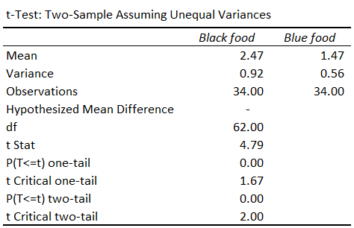
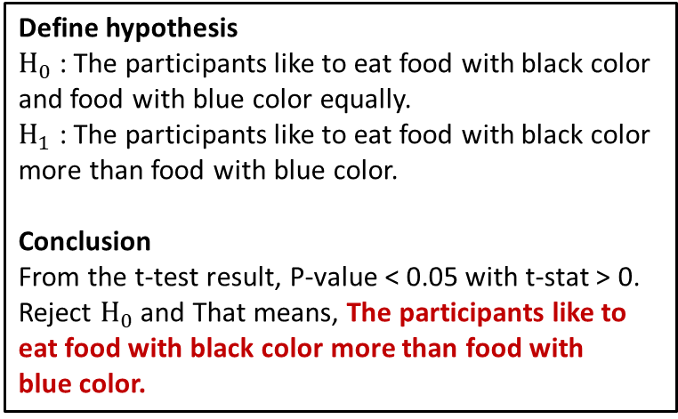
The result
Define hypothesis
$H_{0}$ : The participants like to eat food with black color and food with blue color equally.
$H_{1}$ : The participants like to eat food with black color more than food with blue color.
Conclusion
From the t-test result, P-value < 0.05 with t-stat > 0. Reject $H_{0}$ and That means, The participants like to eat food with black color more than food with
blue color.
The conclusion from t-test
Participants prefer to eat food with
Orange > Red > Green > Black > Blue.

Slide 7
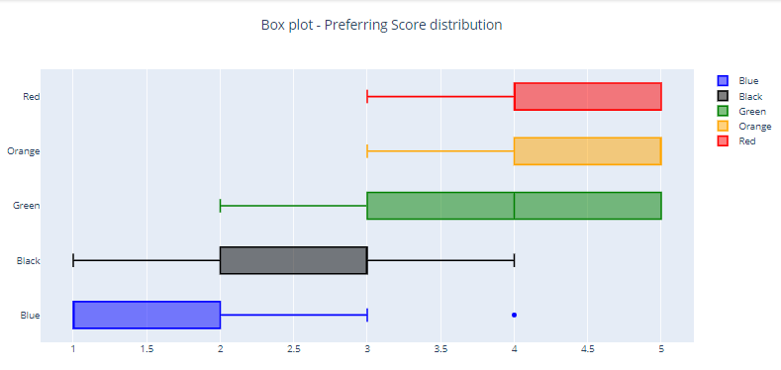
Score distribution

